Slide 1
Traffic sign recognition using Deep Learning
Team Details
G. Sanjay Deep( 20EG105414)
V. Hemanth(20EG105450)
D. Nithin Reddy20EG105408)
Project Supervisor
Name : Mr. E. Radha Krishnaiah
Designation : Assistant Professor

Slide 2
Introduction
With the rapid development in societal and economical section, automobiles have become almost one of the convenient modes of transportation in each household.
As one of the more important functions, traffic sign detection and recognition system, has become a hot research direction of researchers at home and abroad.
In the current traffic system there may be the probability of drivers missing the traffic sign because of traffic or even the drivers might ignore the traffic sign. With the continuous growth of urbanization this problem is only expected to grow worse.

Slide 3
Introduction
Applications:
Traffic sign classification
Lane detection and management
Speed limit recognition
Stop sign detection
Wrong way detection

Slide 4
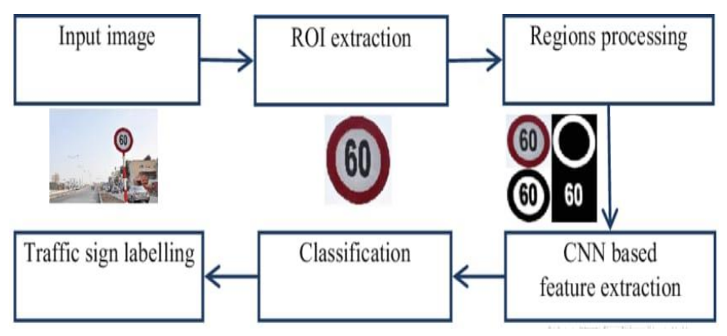
Problem Statement
Problem statement
The challenge is to develop a computer vision system that can accurately detect and classify traffic signs within images, even in adverse weather conditions that affect image quality. The primary objective is to enhance road safety by providing drivers with real-time, dependable information.
Illustrate the problem

Slide 5
Proposed Method
Convolutional Neural Networks (CNN):
By applying deep learning to this problem, we create a model that reliably classifies traffic signs, learning to identify the most appropriate features for this problem by itself.
A deep learning based road traffic signs recognition method is developed which is very promising in the development of Advanced Driver Assistance Systems (ADAS) and autonomous vehicles.
The system architecture is designed to extract main features from images of traffic signs to classify them under different categories.
The training is conducted using the Traffic Sign Dataset and achieves good results on recognizing traffic signs.

Slide 6
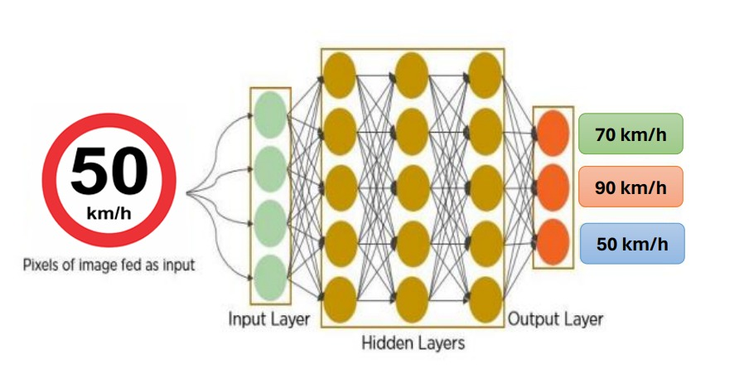
Proposed Method

Slide 7
Experiment Environment
Experiment environment used:
Domain - Machine Learning ( Deep learning )
Software used - jupyter notebook and python
Software requirements -
Technology/Language : python
Operating System : windows
Libraries : keras, CV2, sklearn
Hardware requirements -
Processor : Intel or AMD
Ram : 1 GB or above
Hard disk : 40GB or above

Slide 8
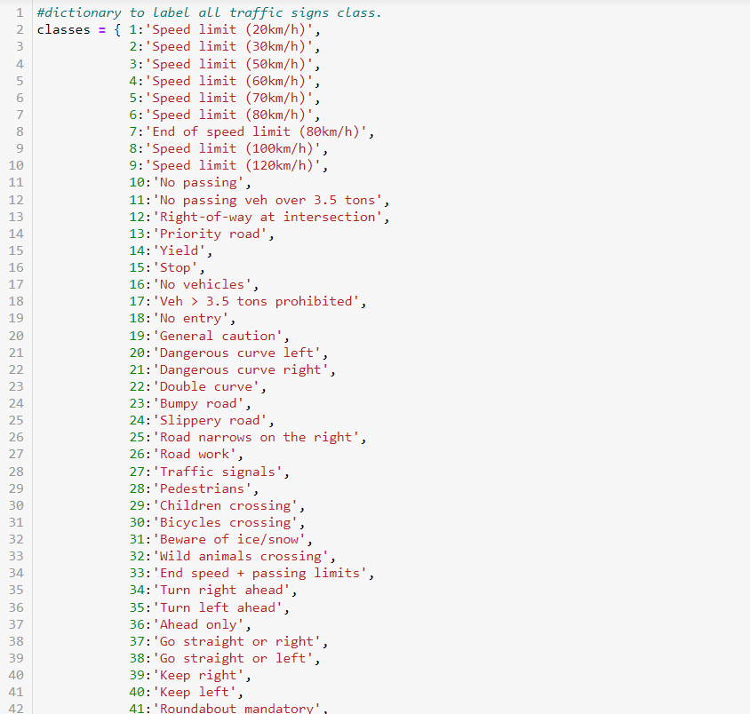
Experiment Screen shorts

Slide 9
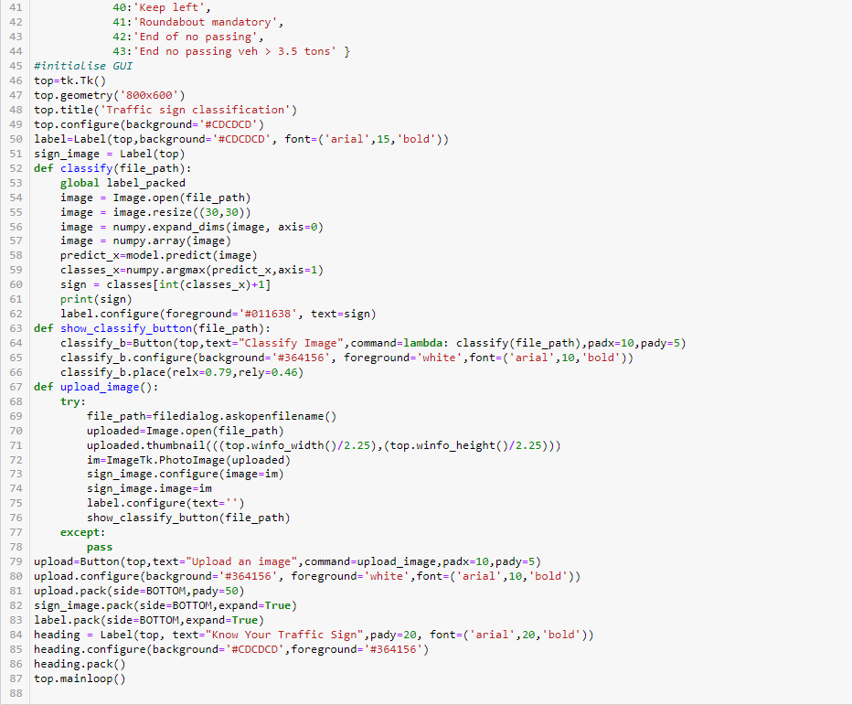
Experiment Screen shorts

Slide 10
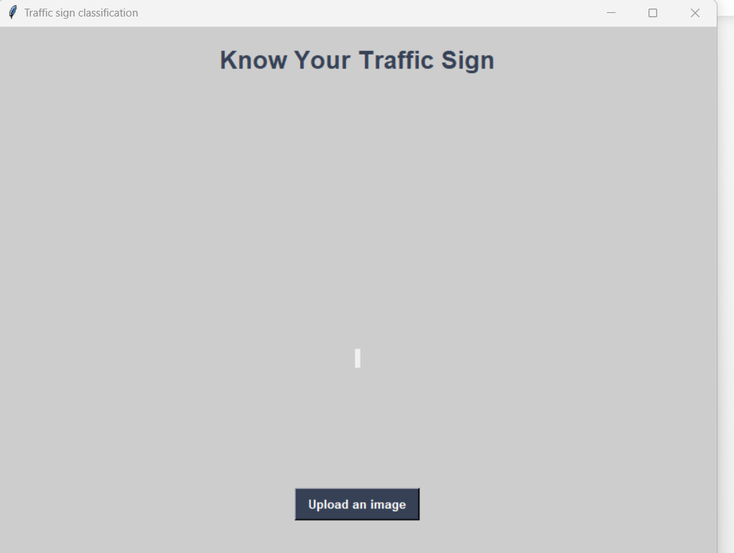
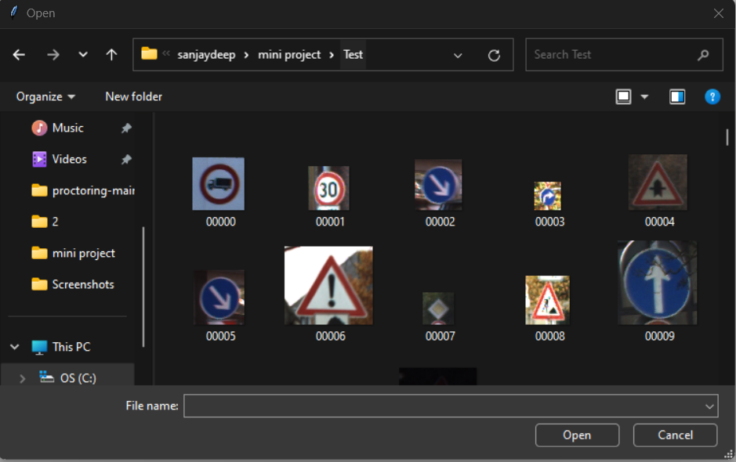
Experiment Results

Slide 11
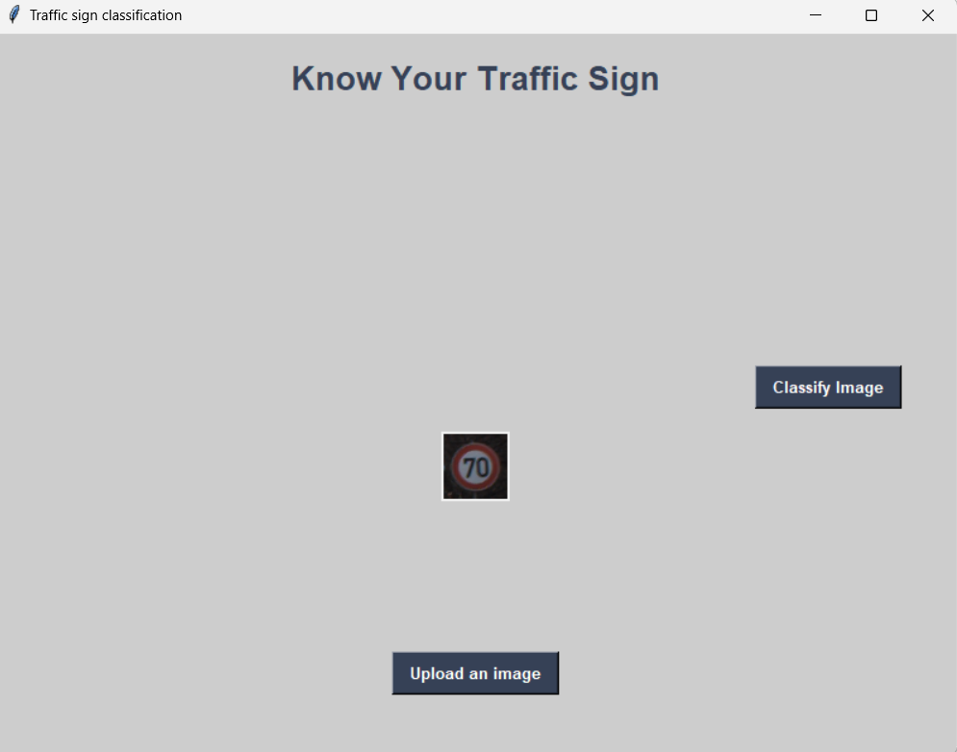
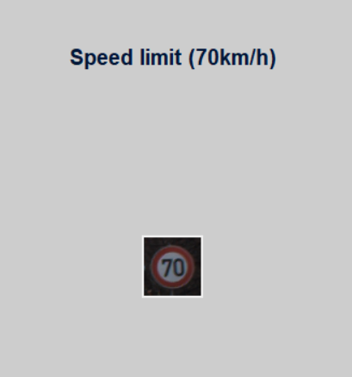
Experiment Results

Slide 12
Finding
We have discovered that we have improved the accuracy and made a program which can detect and recognize the traffic signs in any weather conditions.

Slide 13
Justification
Parameters improved :-
Accuracy
Loss
Mathematic formulas for calculating parameter values
Accuracy = Number of correct predictions / Total number of predictions
why your parameter values improved?
We used Convolution Neural Networks ( CNN ) which makes the process faster.

